Slide 1
CONVERSION OF INFIX EXPRESSION TO POSTFIX EXPRESSION USING C-PROGRAMMING
MOHAMMED BASIL R (192210640)
ABDUL RAYYAAN A R (192210532)
KEERTHANAA S(192211016)

Slide 2
Introduction
Infix expressions are common in everyday arithmetic where operators are placed between operands (e.g., `A + B`). Postfix expressions, where operators follow their operands (e.g., `A B +`), are advantageous in computer science for simplifying the parsing and evaluation processes. The conversion from infix to postfix is crucial in the design of compilers and expression evaluators.
The objective of this project is to develop a robust C program to convert infix expressions to postfix expressions. The program should handle:
Basic arithmetic operations (`+`, `-`, `*`, `/`)
Parentheses for explicit precedence control
Operator precedence and associativity rules

Slide 3
Concepts
Infix
Postfix
The expression of the form “a operator b” (a + b) i.e., when an operator is in-between every pair of operands.
The expression of the form “a b operator” (ab+) i.e., When every pair of operands is followed by an operator.

Slide 4
Program design
Tokenisation
Stack operation
Conversion Logic
Breaking down the infix expression into operands and operators.
Managing the stack for operators.
Implementing the Shunting Yard algorithm.

Slide 5
Applications
Compiler and Interpreter
Expression Evaluator
Stack-Based Virtual Machine
Compilers convert high-level programming language code into machine code. During this process, they need to evaluate expressions, making the infix to postfix conversion crucial.
Many calculators and mathematical software tools use postfix notation to simplify the evaluation of complex expressions.
Postfix notation aligns well with the operation of stack-based virtual machines, which are used in various programming languages and environments.

Slide 6
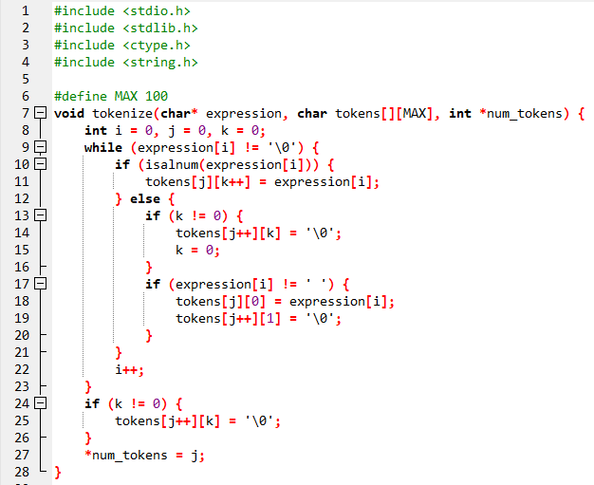
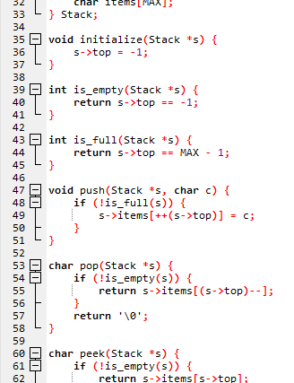
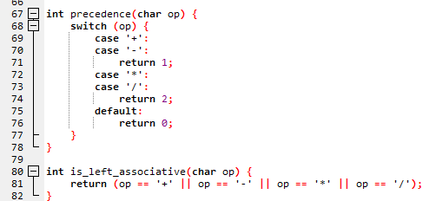
CODE IMPLEMENTATION:
Tokenizer Function
Precedence and Associativity Functions
Stack Implementation

Slide 7
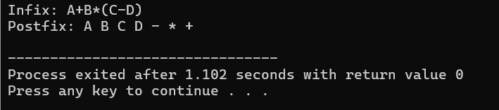
RESULT
When the program is compiled and executed, it successfully converts the given infix expression to a postfix expression. The program correctly handles operator precedence, associativity, and parentheses.

Slide 8
THANK YOU
For more info kindly contact
MOHAMMED BASIL R
PHN NO:6383029537
ADDRESS: VEPERY(NEAR CENTRAL)
STATUS:SINGLE

